Slide 1
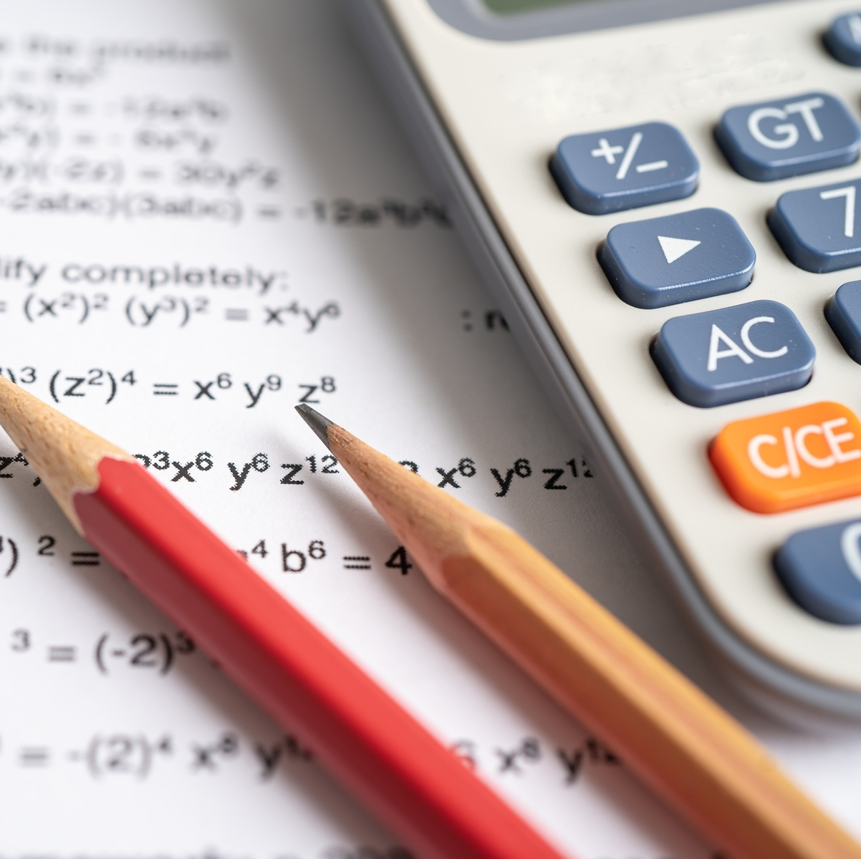
Role of calculators in youth empowerment
Pranav Mahant
Mukhtar Hamzat
Minhquan Nguyen

Slide 2
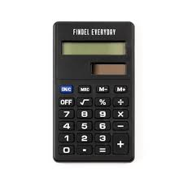
The Plan
IDE: GitHub
Function: Basic mathematic processes
Goal: Create a very basic working calculator

Slide 3

Issues encountered
Time
Calculation Errors
Programming language choice
Had to start over

Slide 4
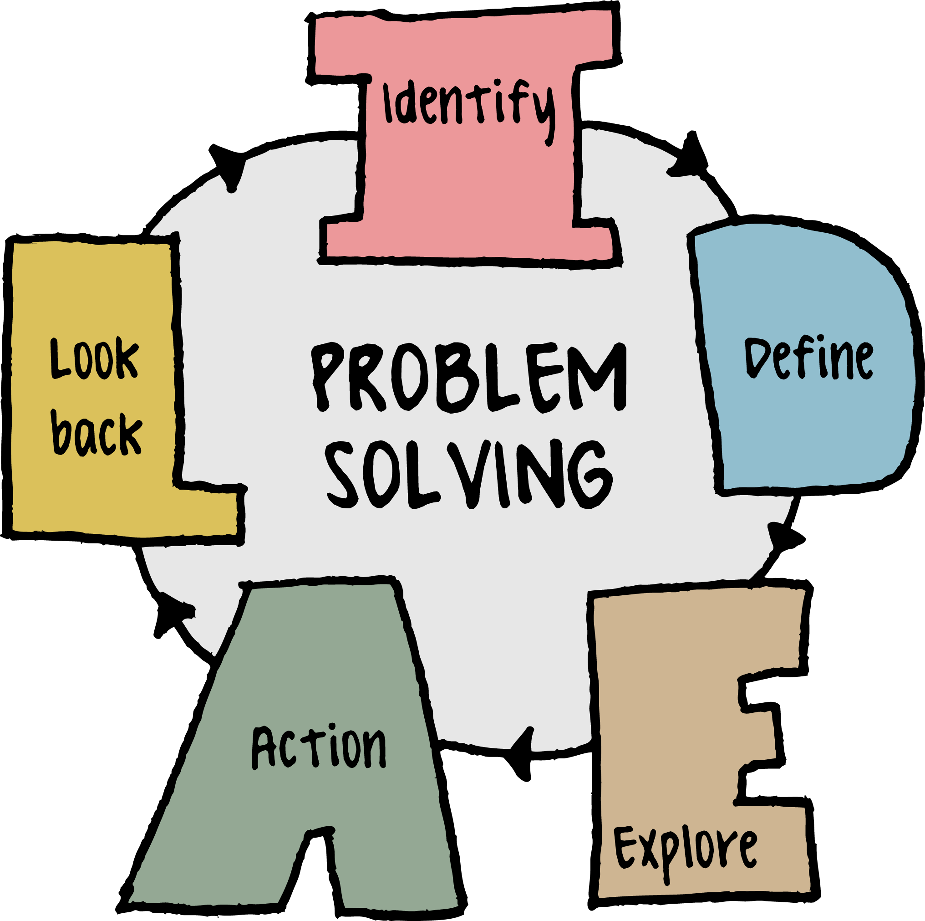

Problem Solving
Calculation Error
Restart
Coding Language
Time Management

Slide 5

Future Plans
Increase calculator functionality
Add as a browser extension
Make it an app

Slide 6


The Theme: Youth Empowerment
Less room for error
Promotes time management
Allows advanced calculations
Improves study habit

